Slide 1
Employee Data Analysis using Excel
STUDENT NAME:Gnanasangavi M
REGISTER NO:66CD8CA0AE7D149B93949FC17F51D6E7
DEPARTMENT:B COM(COMMERCE)
COLLEGE:QUE QUEEN MARY'S COLLEGE

Slide 2
PROJECT TITLE
Employee Engagement and survey dataset Analysis using Excel

Slide 3


AGENDA
Problem Statement
Project Overview
End Users
Our Solution and Proposition
Dataset Description
Modelling Approach
Results and Discussion
Conclusion
3/21/2024 Annual Review

Slide 4

PROBLEM STATEMENT
Despite the company’s ongoing efforts to foster a positive work environment, recent employee engagement surveys have revealed critical areas of concern. Key insights from the data highlight:
Work-Life Balance Concerns: A growing number of employees report burnout due to inadequate work-life balance support.

Slide 5

PROJECT OVERVIEW
Purpose:
Measure employee engagement levels
Identify strengths and areas for improvement
Understand employee sentiments on company culture, leadership, etc.
Key Metrics:
Engagement scores
Response rates
Comparison with industry benchmarks (if available)

Slide 6

WHO ARE THE END USERS?
The end users of an employee engagement survey PowerPoint presentation typically include a variety of internal stakeholders who have an interest in the well-being, performance, and satisfaction of the workforce. Here’s a breakdown of the key end users:
1. Senior Leadership and Executives
2. Human Resources (HR) Department
3. Department/Team Leaders and Managers
4. Employees (Survey Participants)
5. Employee Experience or Engagement Teams
6. Organizational Development Teams
7. Board of Directors (Optional)
8. External Consultants (Optional)

Slide 7

OUR SOLUTION AND ITS VALUE PROPOSITION
Pivot table-Employee Name,Satisfaction Score and grand total
Chart-Bar chart

Slide 8
Dataset Description
Employee engagement and survey dataset -Kaggle
Features -8
Employee name,sa satisfaction Score ,grand total

Slide 9

THE "WOW" IN OUR SOLUTION
Employee engagement and survey data solution stand out,focuses On interactive dashboard ,advanced sualisation,predictive analysis and a users friendly interface.
3/21/2024 Annual Review
9

Slide 10
MODELLING
Data Collection Overview
Title: Data Collection Process
Content:
Briefly describe the overall data collection process for the survey.
Example:
“The survey was conducted online between [start date] and [end date]. Employees were invited to participate via email, with reminders sent to non-responders.”
10

Slide 11
Survey Design
Title: Survey Design and Structure
Content:
Questionnaire Format:
Include types of questions used (e.g., Likert scale, multiple choice, open-ended).
Example: “The survey included 25 questions focused on key engagement drivers such as leadership, work-life balance,career development, and recognition.”
Number of Sections: Provide the number of sections the survey was divided into (e.g., job satisfaction, leadership, teamwork, etc.).
Rating Scales: Mention any scales used (e.g., 1–5 scale, where 1 = Strongly Disagree and 5 = Strongly Agree).
Chart/Graph: A pie or bar chart showing participation rates by department or location.

Slide 12
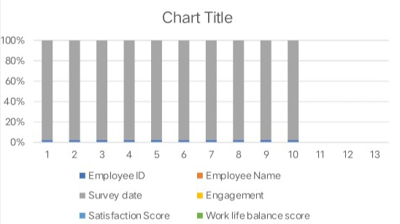
RESULTS
12

Slide 13
conclusion
Summary:
Surveys help in diagnosing engagement issues.
Actionable insights can significantly improve engagement levels.
Next Steps:
Conduct the employee survey
Analyze the data
Implement action plans
Monitor progress and continuously improve

